Slide 1

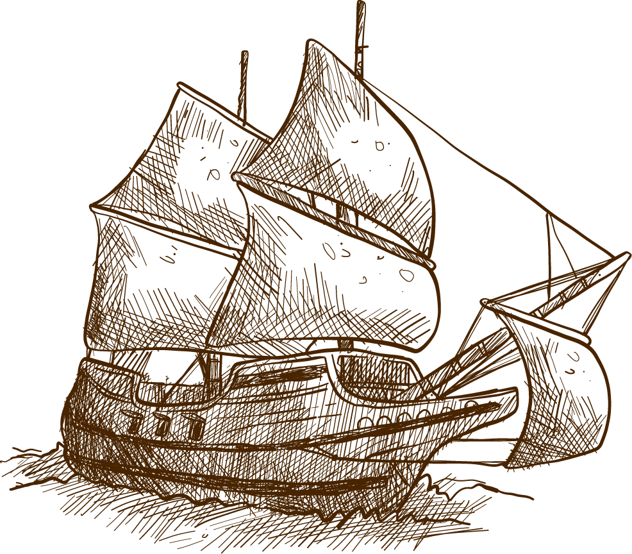


Konquest
A strategy Game
Grant Petitt, Joshua Goller, Big Jon
https://github.com/jsgoller1/konquest
Notes:
Title Card

Slide 2
What is a game?
Notes:
Introduction
Provide a clear overview of the project's objectives and scope

Slide 3
What is a game?
“Organized collection of things that respond to input and evolve over time”
game world := “organized collection”
actors := “things”
player := “respond to input”
game loop := “evolve over time”
Notes:
Introduction
Provide a clear overview of the project's objectives and scope

Slide 4
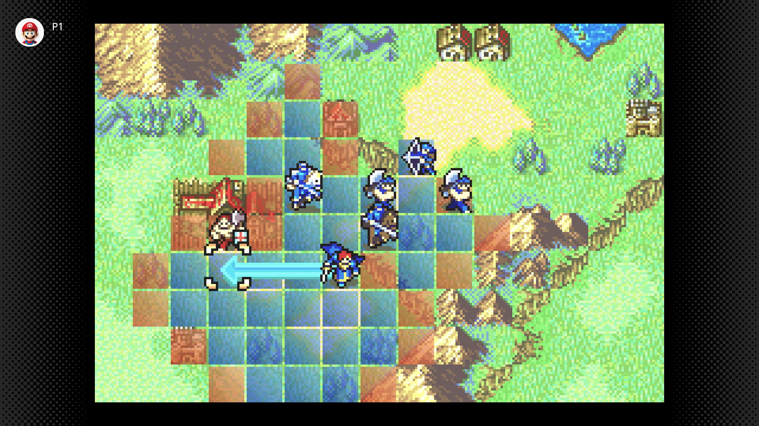

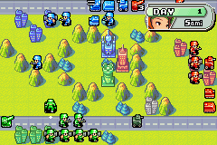

Overview
Scope:
Playable Board
Player Unit & Input
Enemies & AI
Turn System
Pathfinding
Assets & Audio
Objective:
Make a java-based retro style strategy game
Inspiration:
Fire Emblem: The Sacred Stones (2004)
Battle for Wesnoth (2005)
Advance Wars (2001)
Notes:
Introduction
Provide a clear overview of the project's objectives and scope

Slide 5
Methodology: Overview
Architecture
Core game loop
GameBoard container
Position problem - cache!
Input management (currently buggy)
Turn management
Graphics
Spritesheet Textures
Animation
Damage flash via pixel mask
Makefile build system / GitHub workflow
Tunable Logging
Pathfinding
Behavior FSM for AI
Music player
Notes:
Conclusion Summarize the key points discussed and propose any future directions or areas for improvement.
Sprite picture is grouped if you want to edit it btw

Slide 6
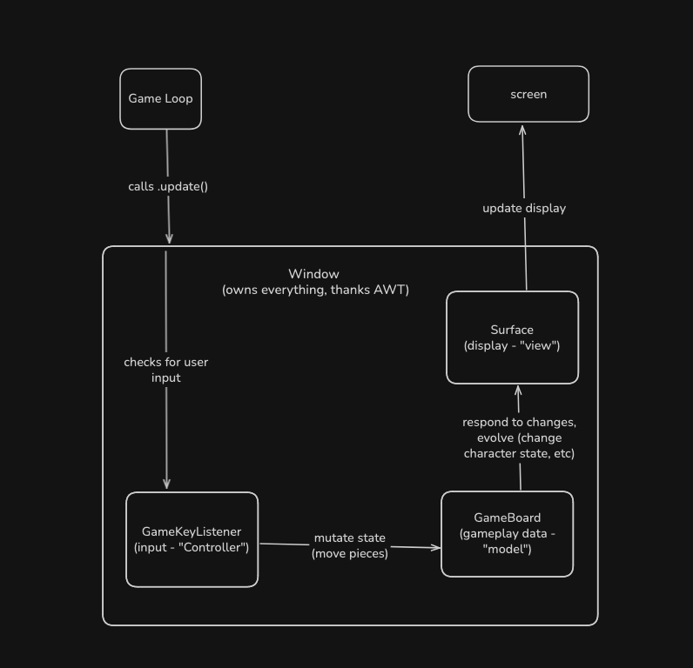
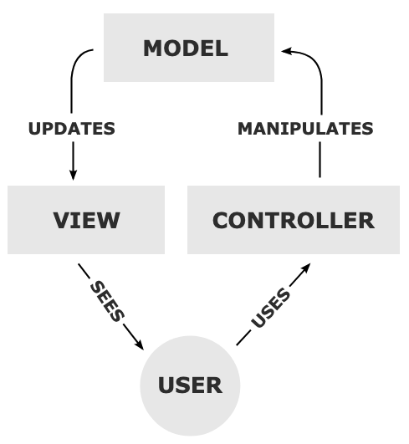

Methodology:
Architecture
Based on game-loop driven MVC
Notes:
Methodology
Explain the methods and techniques used to address the project goals

Slide 7
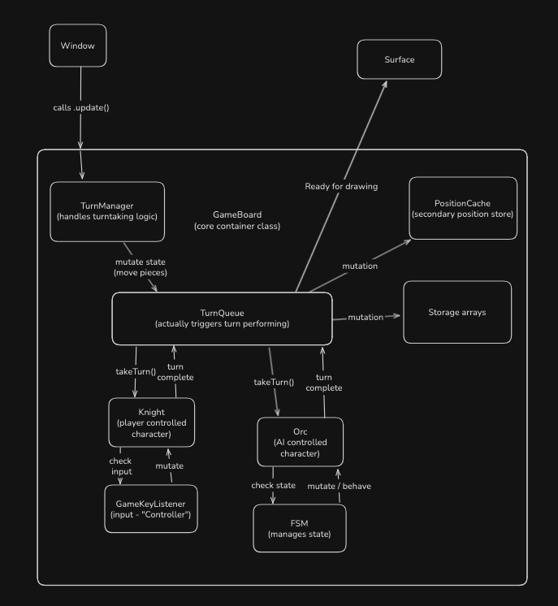
Methodology:
Architecture
Proper abstraction (SOLID)
Use of Position as dep. inversion
Composition over inheritance
Position problem!
Grid -> easy location lookup
Game logic -> need actor/actor interaction
Notes:
Methodology
Explain the methods and techniques used to address the project goals

Slide 8

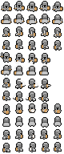
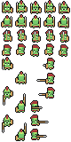
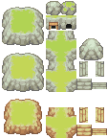
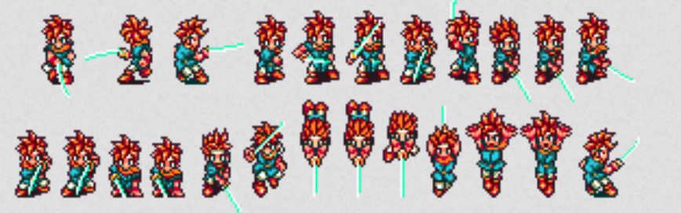

Methodology: graphics/Animation
Java2D / Swing
3D = path to hell (hard on performance, collisions / z-fighting, realism is hard, etc)
Sprite based
Involves forced delay between updates
Pixel masking for damage (in demo)
Sprites used
Notes:
Conclusion Summarize the key points discussed and propose any future directions or areas for improvement.
Sprite picture is grouped if you want to edit it btw

Slide 9
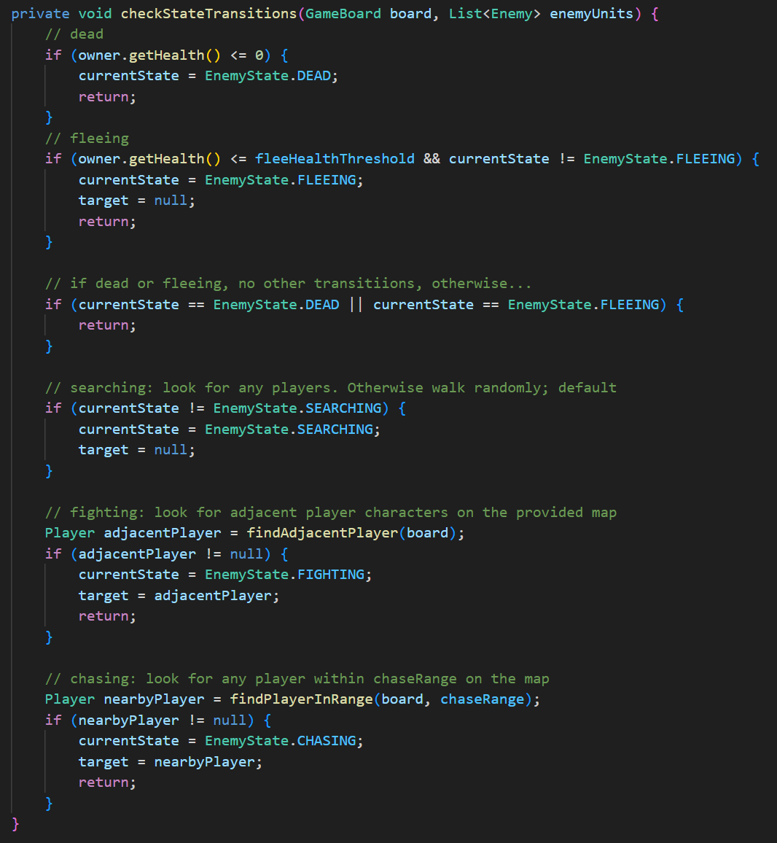

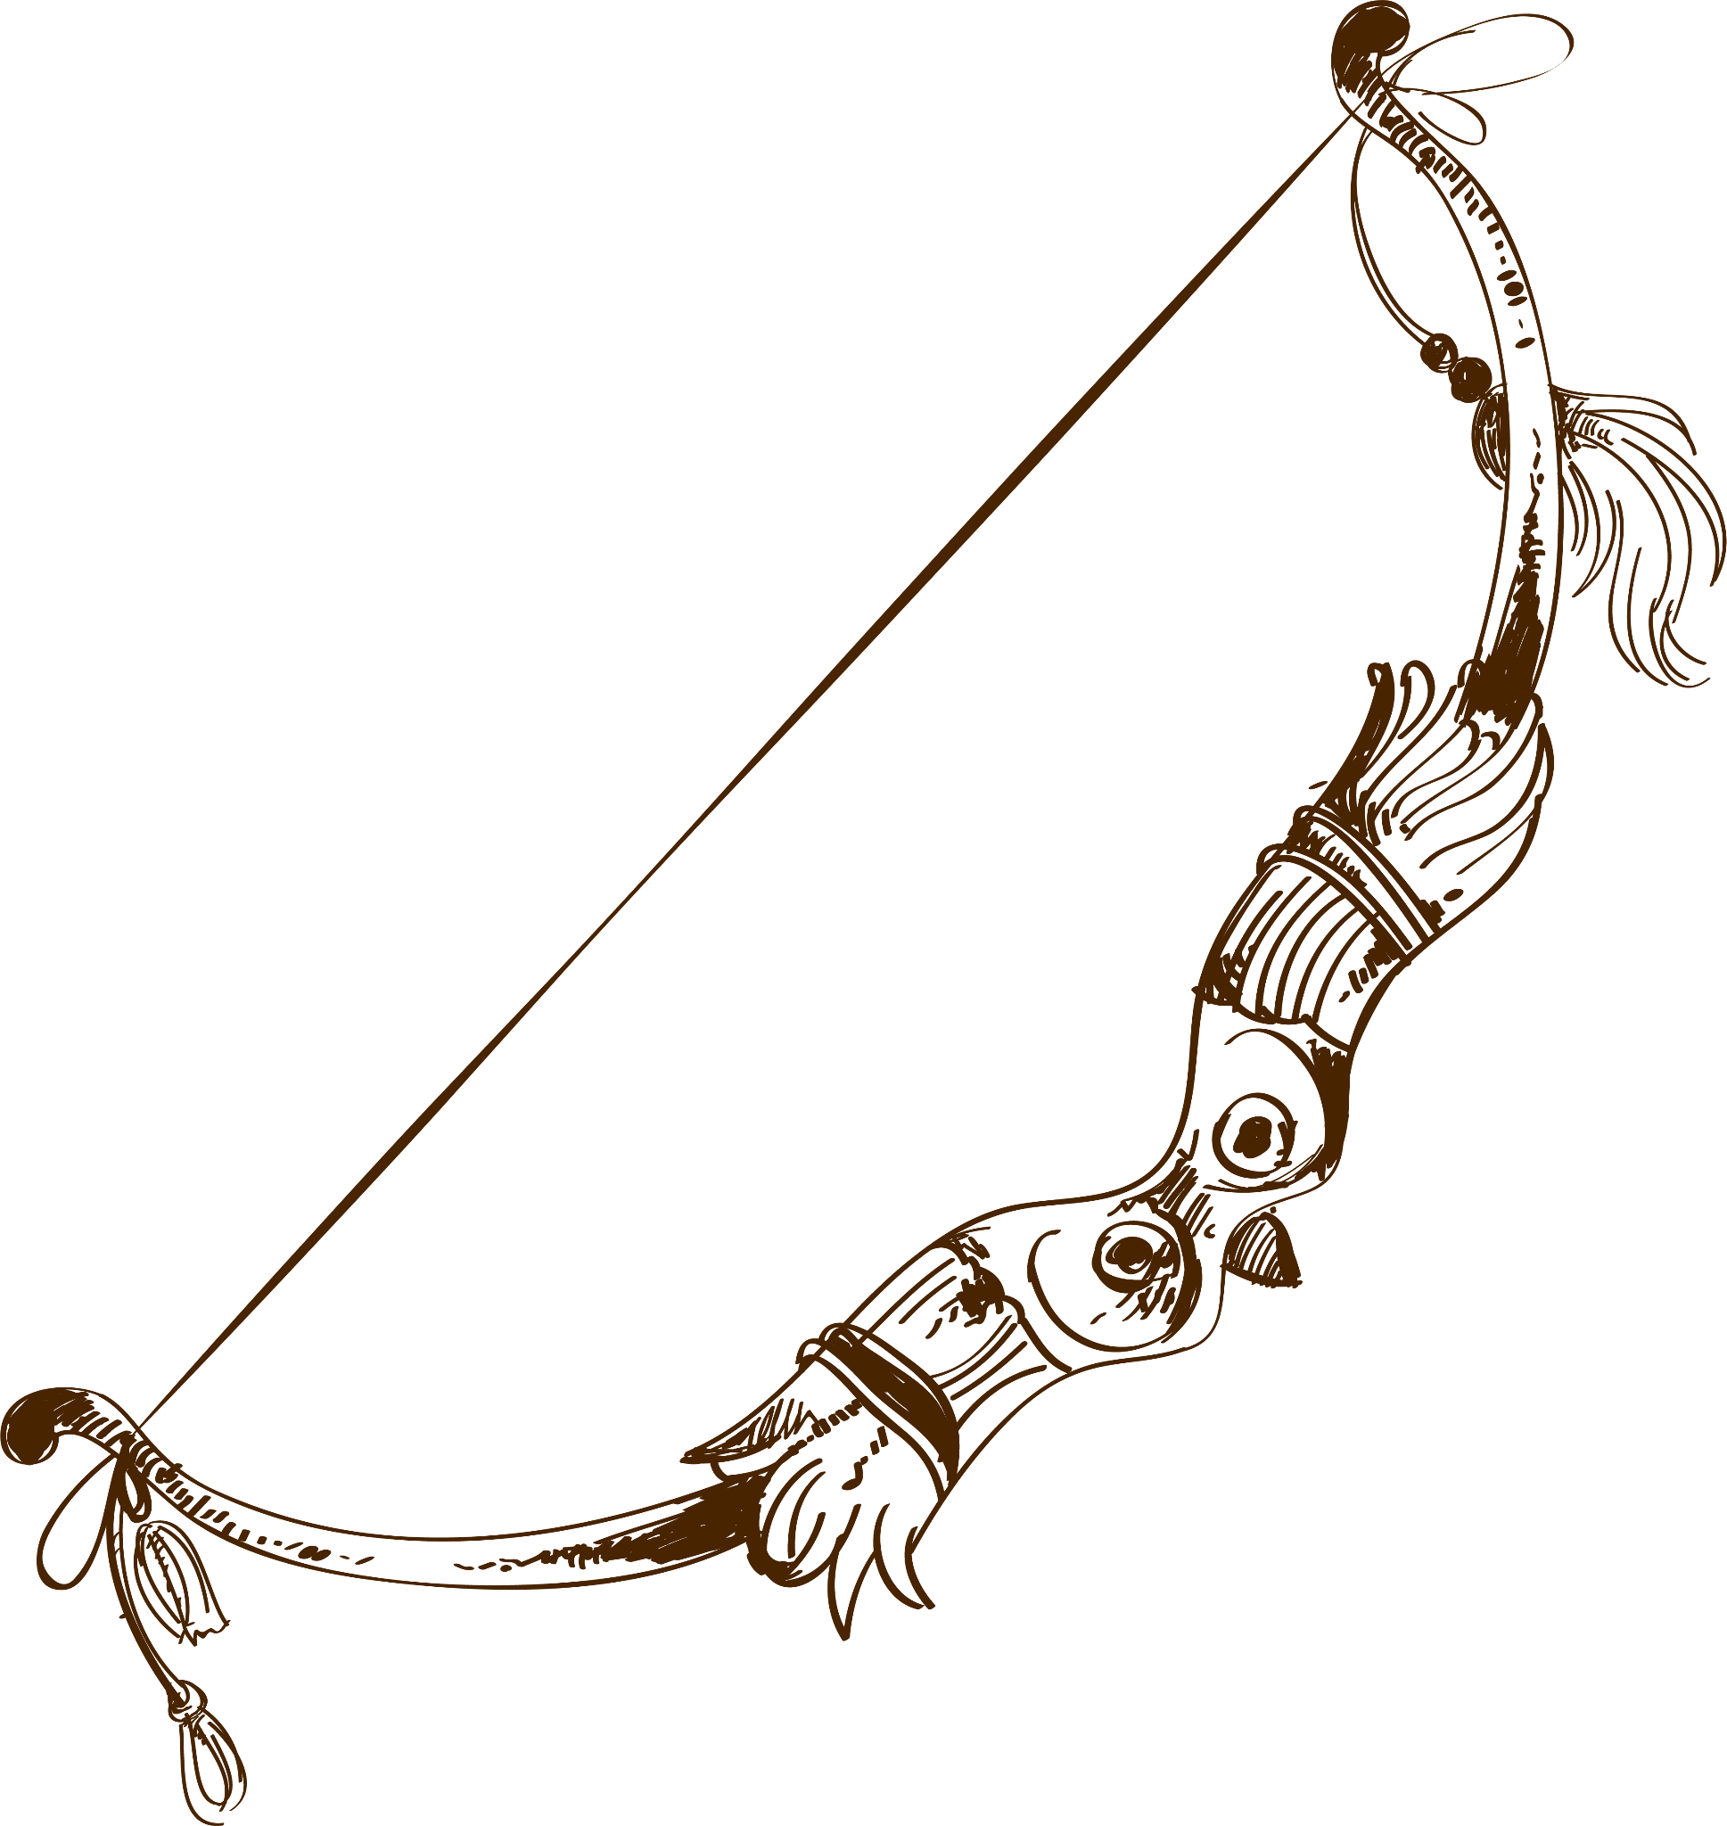
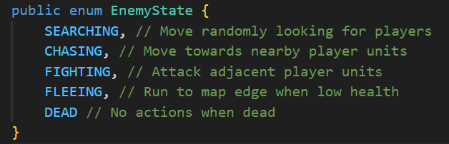
Methodology:
Behavior FSM
Implemented a Behavior Finite State Machine
Used to determine state of enemy units and how they will act
SEARCHING (Default)
CHASING (Player in range)
FIGHTING (Next to player)
FLEEING (Low Health)
DEAD (Zero health)
Notes:
Code Review
Allocate a specific section for code review, where team members can showcase and explain key sections of the codebase

Slide 10
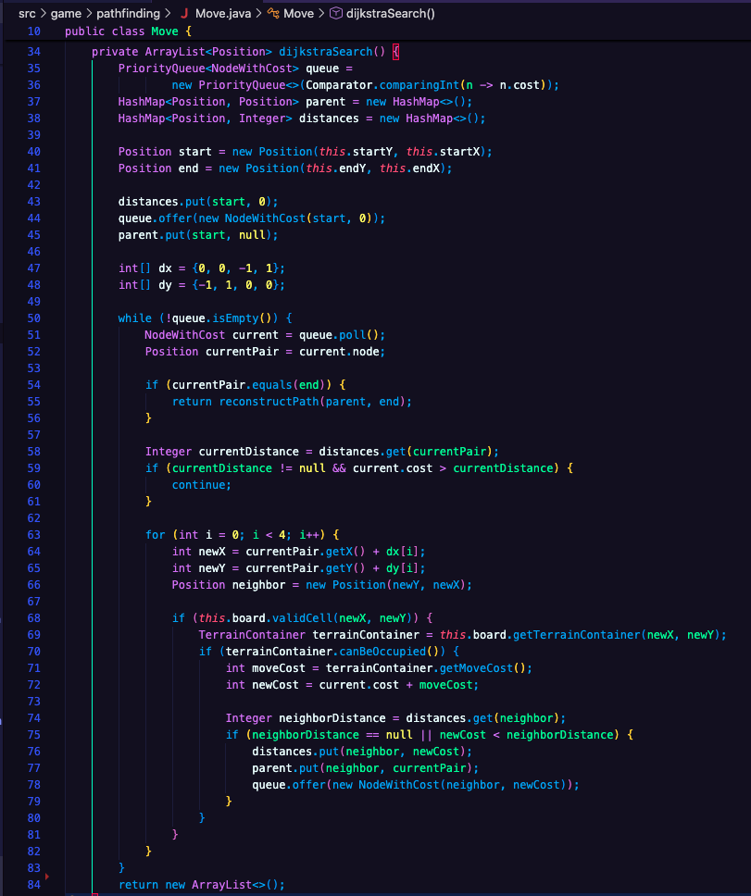


Methodology:
Pathfinding
Grid based Dijkstra’s algorithm
Input: starting and ending coordinates
Output: shortest path from the start to end
Notes:
Demo
Incorporate a live or recorded demo of the project

Slide 11
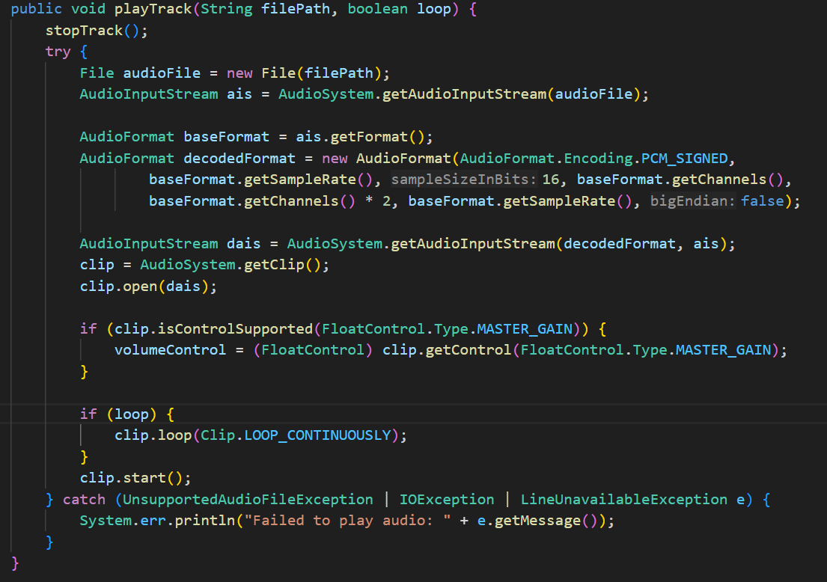

Methodology: Music Player
Plays music in the background with optional looping
Uses WAV files
Also has a setVolume method
Plays one of three tracks when game runs
Notes:
Code Review
Allocate a specific section for code review, where team members can showcase and explain key sections of the codebase

Slide 12
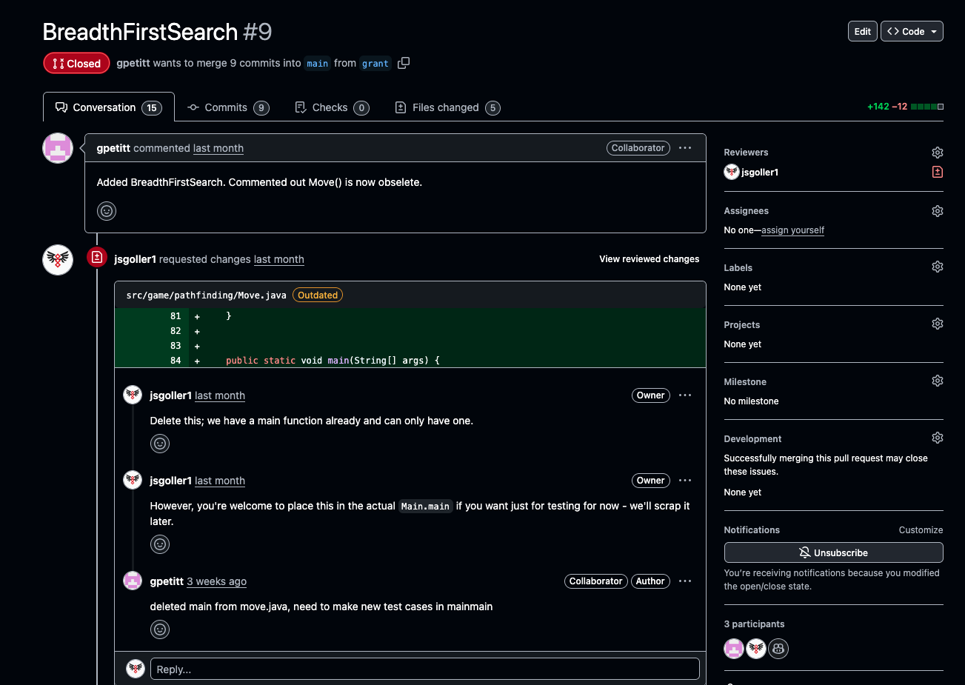
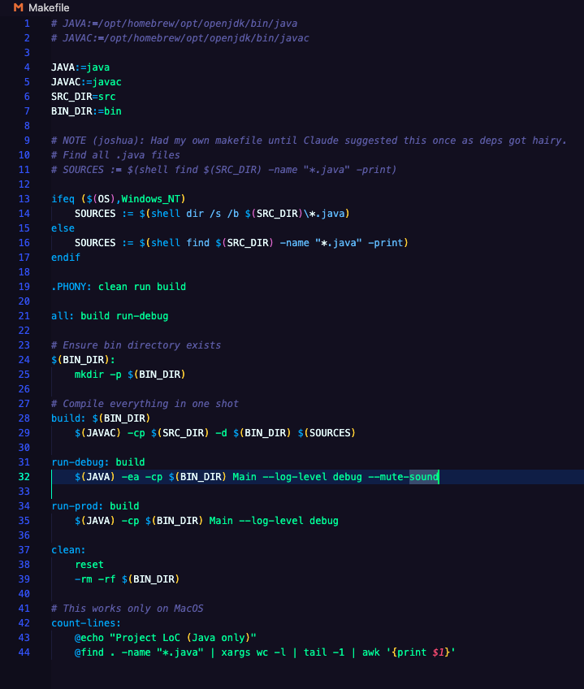

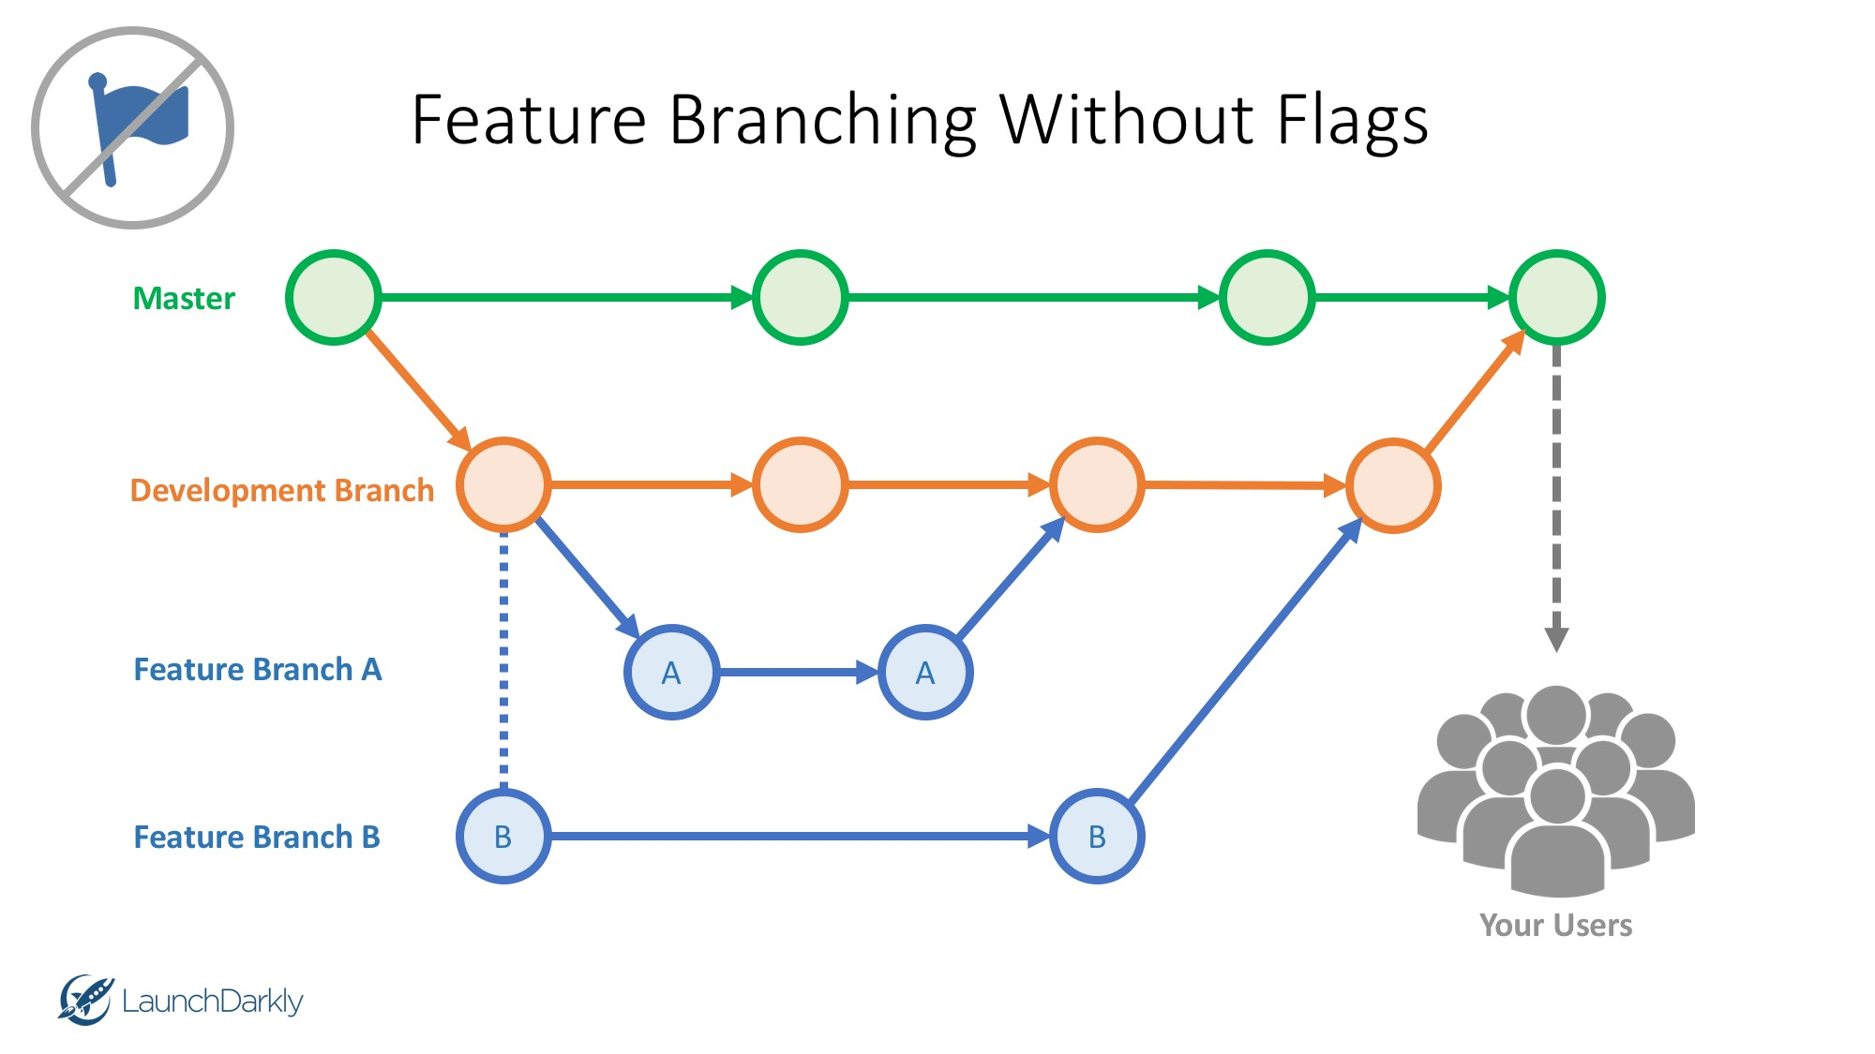
Methodology: Makefile and Github
Game dev is hard to do collaboratively!
Big 3D assets, different industry practices
Notes:
Methodology
Explain the methods and techniques used to address the project goals

Slide 13
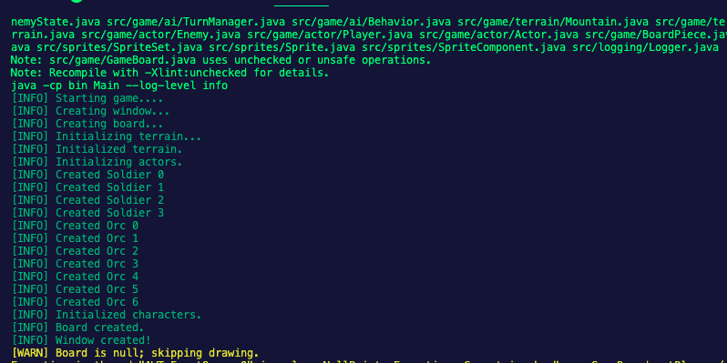
Methodology: Tunable Logging
Notes:
Methodology
Explain the methods and techniques used to address the project goals

Slide 14
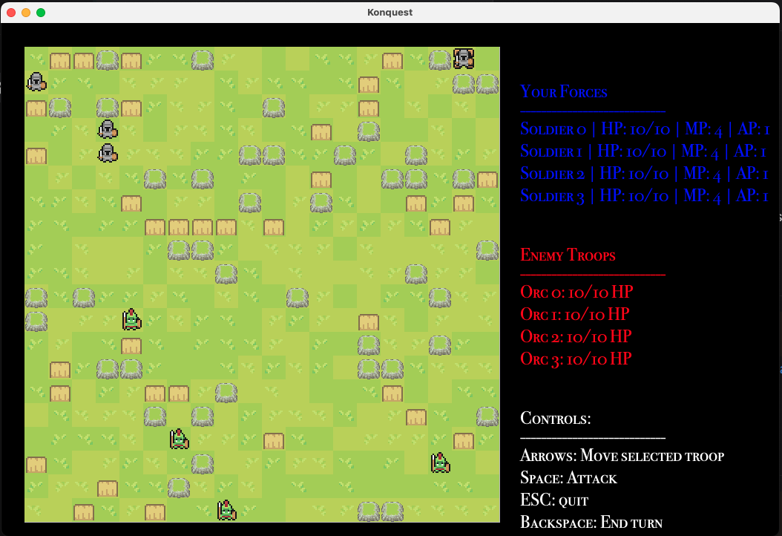

Results
Made a game!
GPL v3
~2100 LoC (Java)
Small amount GPT generated (mostly helper methods)
Notes:
Results
Present the findings, outcomes, or solutions obtained from the project

Slide 15
A Demo!
Results
Known bugs:
Orcs sometimes get stuck on pathfinding (requires restarting)
Input can be sensitive
Notes:
Demo
Incorporate a live or recorded demo of the project

Slide 16





Discussion
Analysis:
Input is a bit sensitive
Orc stuck on loop
Challenges:
Github was initially hard to manage, but became easier
Making sure to use getter methods rather than pull directly from variable
Significance:
Made a full game entirely with Java
Notes:
Discussion Analyze the results, discuss any challenges encountered, and highlight the significance of the findings

Slide 17
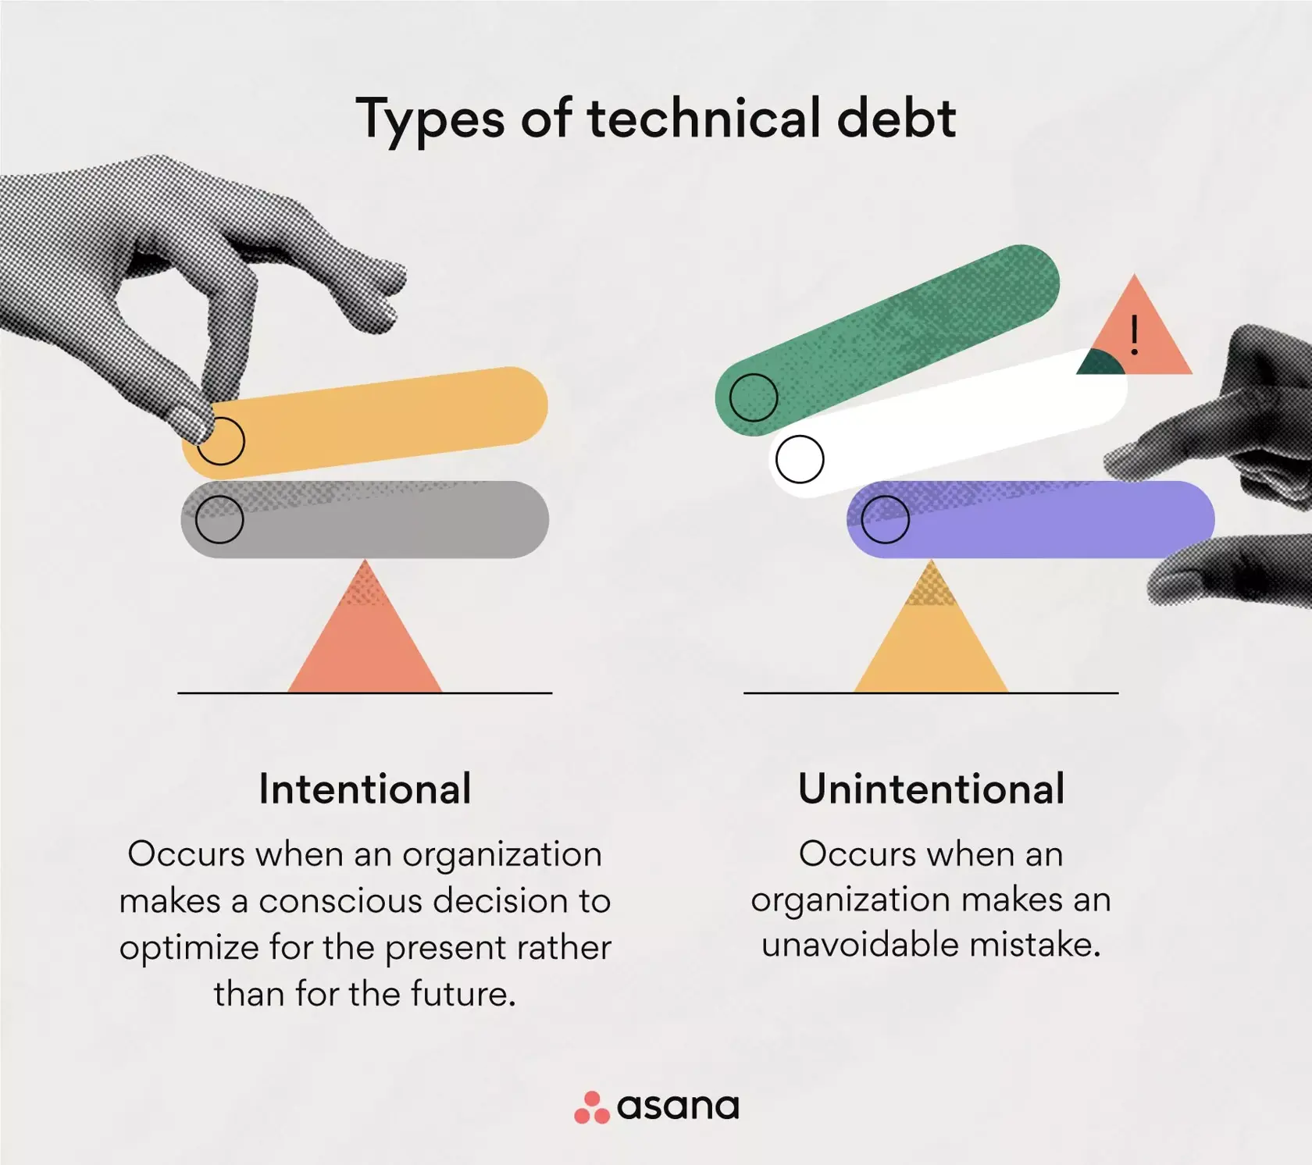
Discussion: “Worse is Better”
“UNIX philosophy” (Richard Gabriel - Lisp)
Sometimes doing the “right” thing is expensive and not worth it
Doing it “wrong” can actually produce better results
Further reading: https://dreamsongs.com/WorseIsBetter.html
Notes:
Discussion Analyze the results, discuss any challenges encountered, and highlight the significance of the findings

Slide 18
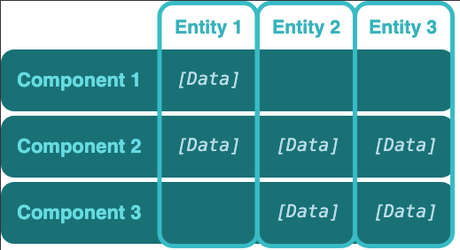
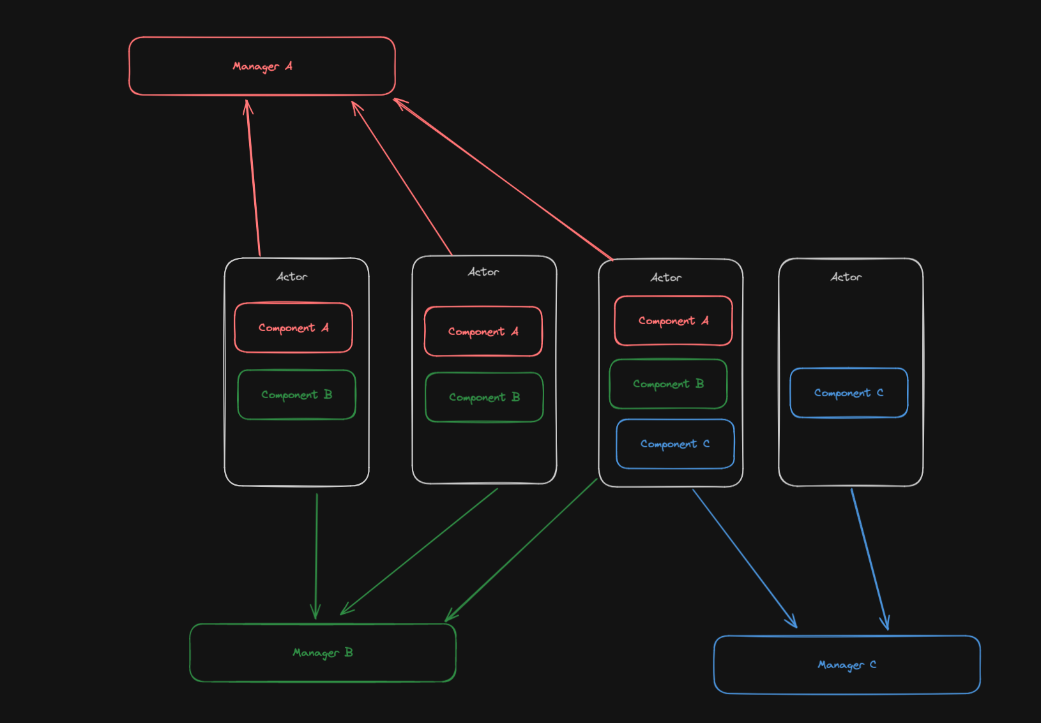
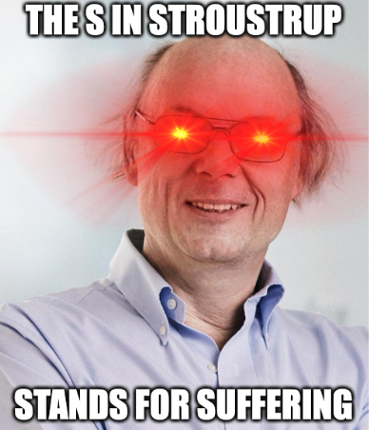
Discussion: “Worse is Better”
OOP design tradeoffs are not easy!
Notes:
Discussion Analyze the results, discuss any challenges encountered, and highlight the significance of the findings

Slide 19
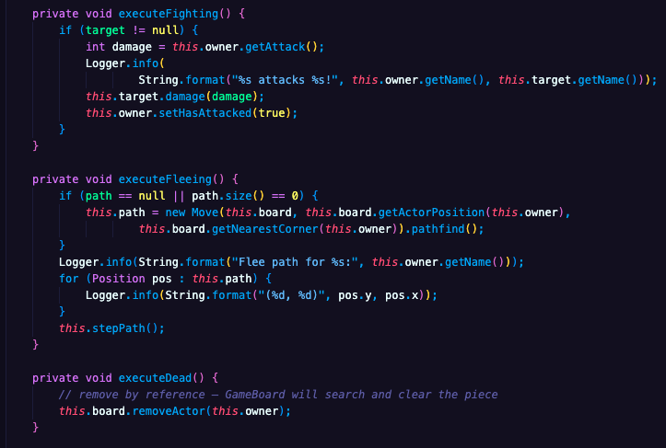
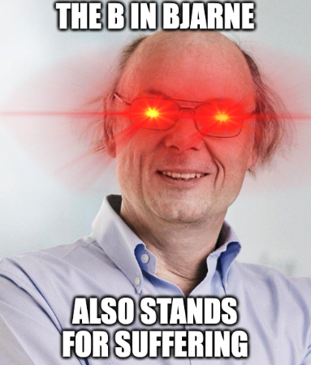
Discussion: “Worse is Better”
OOP design tradeoffs are not easy!
Notes:
Discussion Analyze the results, discuss any challenges encountered, and highlight the significance of the findings

Slide 20

Conclusion
Summary:
We made a strategy game!
With different units and map tiles
Future Goals:
More environment pieces (ex. Water tile)
More types of units (ex. Archer, Rider)
Fun fact:
For Joshua’s part, 30x more lines of code over ~2 days than entire year of work at Meta.
No, this is not a joke.
Notes:
Conclusion Summarize the key points discussed and propose any future directions or areas for improvement.

Slide 21
Credits
Everyone made meaningful contributions
Differing skill levels -> carve out accomplishable goals for impact
Major focus: learn agile methods and tools
Collaboration is the biggest challenge in software development.
Big Jon:
Initial turn queue (later refactored)
FSM logic
Music player
Grant:
Pathfinding (BFS and Dijkstra’s)
Hard - this was before we got to graphs in class
Joshua:
Everything else
Notes:
Conclusion Summarize the key points discussed and propose any future directions or areas for improvement.

Slide 22
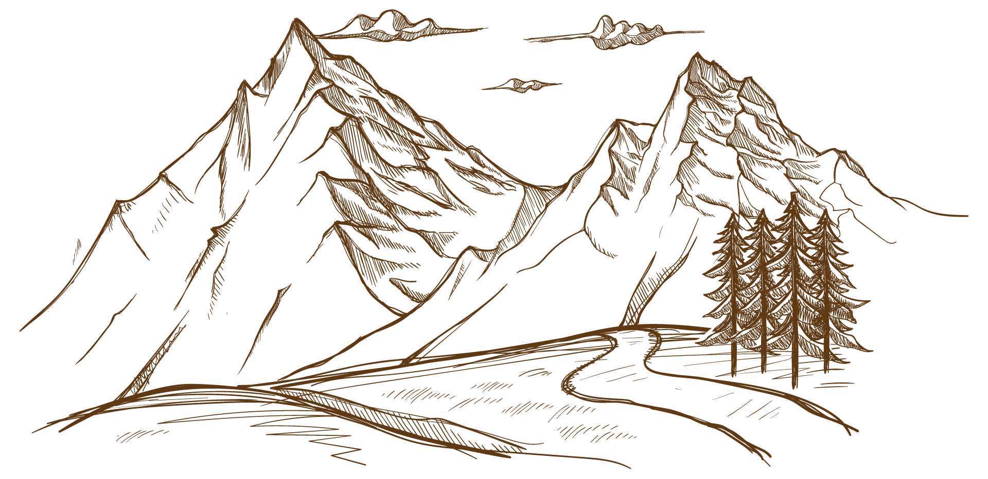

THANK YOU!
https://github.com/jsgoller1/konquest
Notes:
The End

Slide 23
Methodology
Turn Order
A simple priority queue to be used for all units
Pathfinding
Dijkstra's + Breadth First Search
Enemy AI
Behavior FSM to control enemy states and moves
Notes:
Methodology
Explain the methods and techniques used to address the project goals

